Slide 1

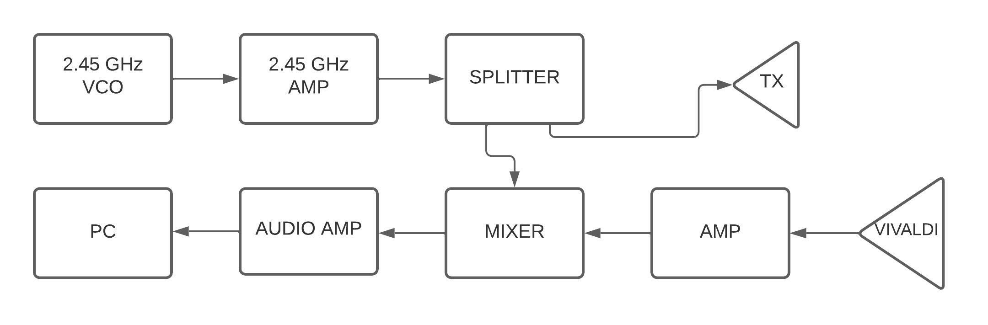
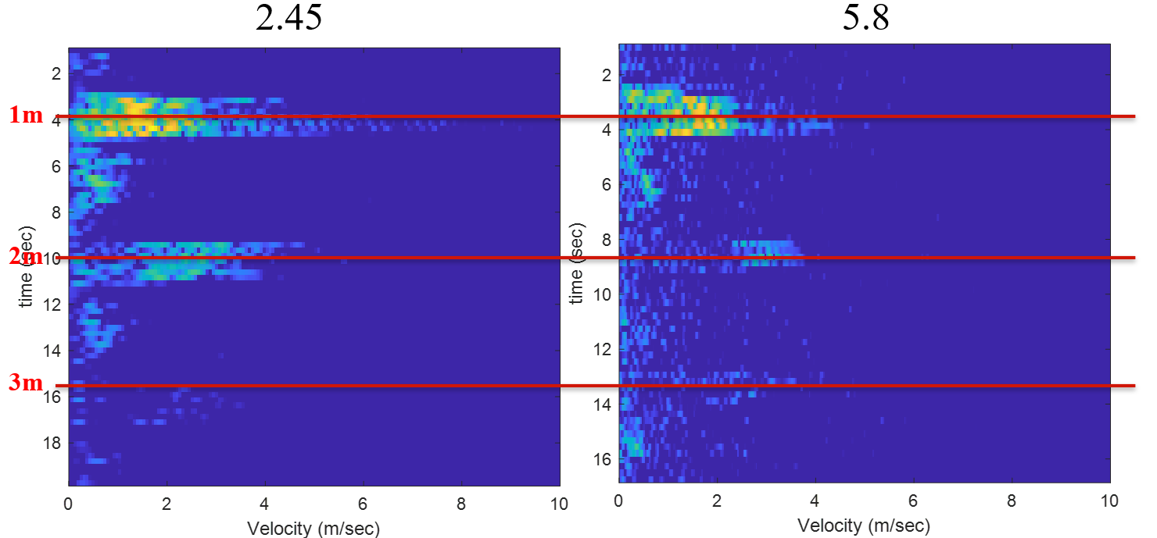
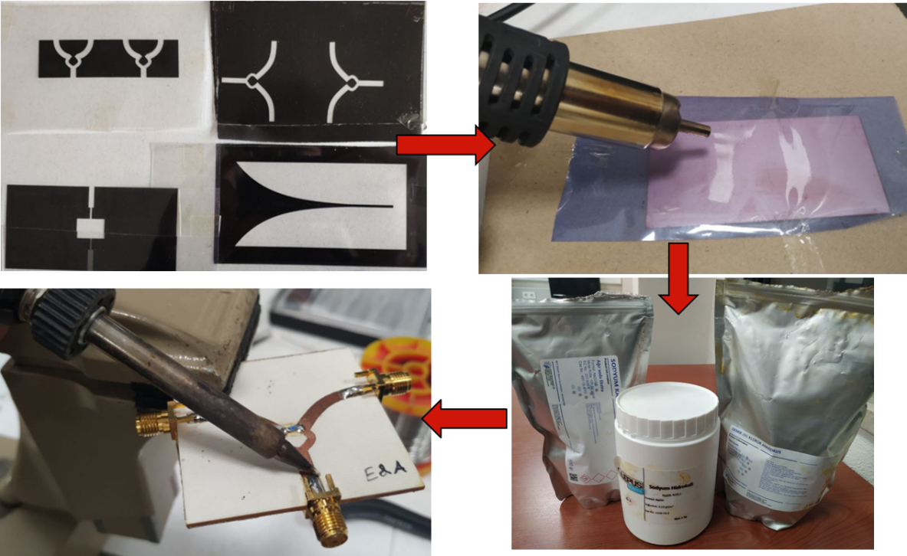
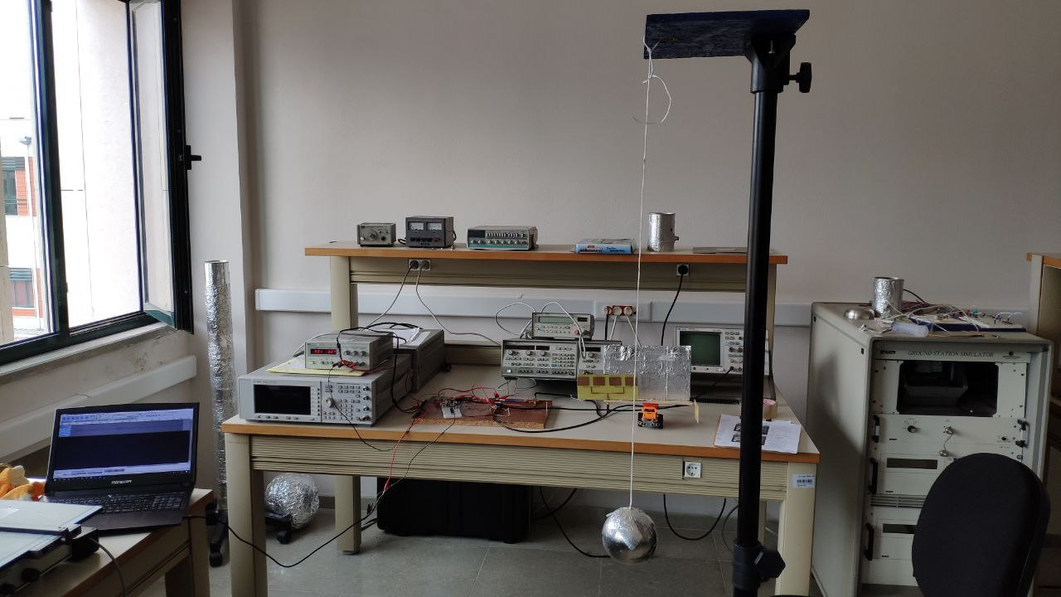
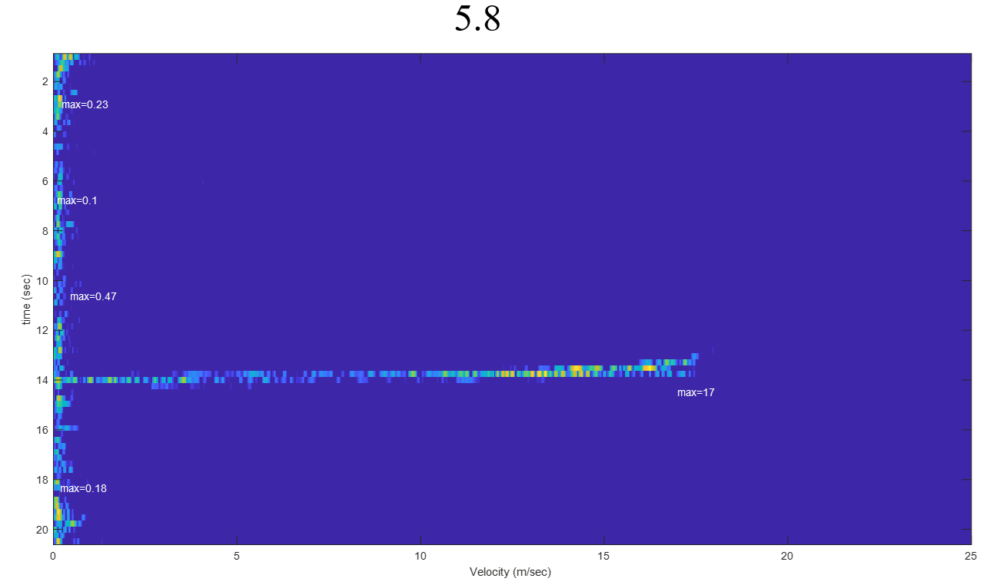
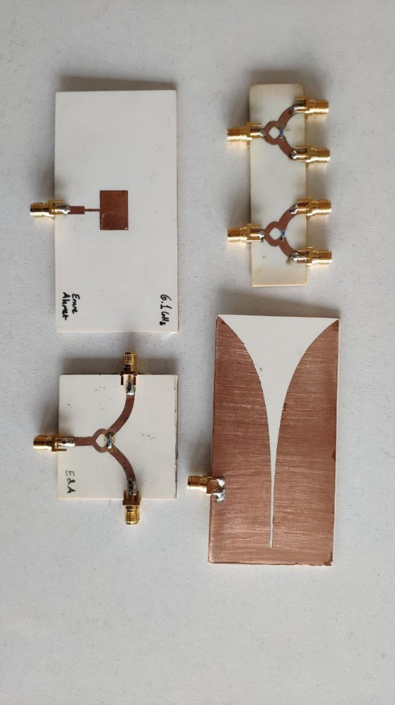
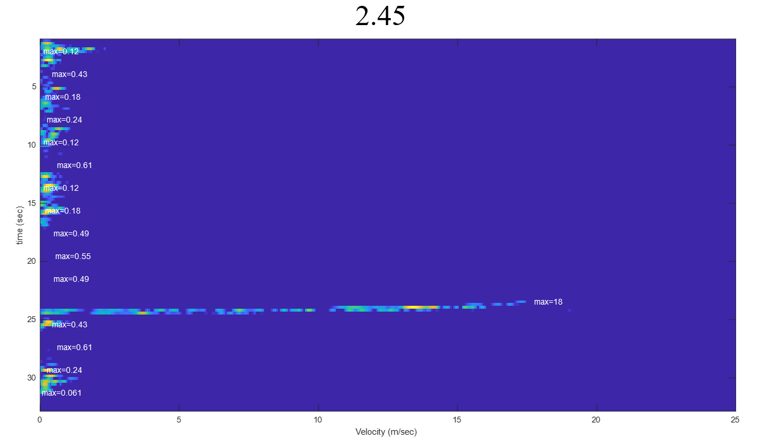
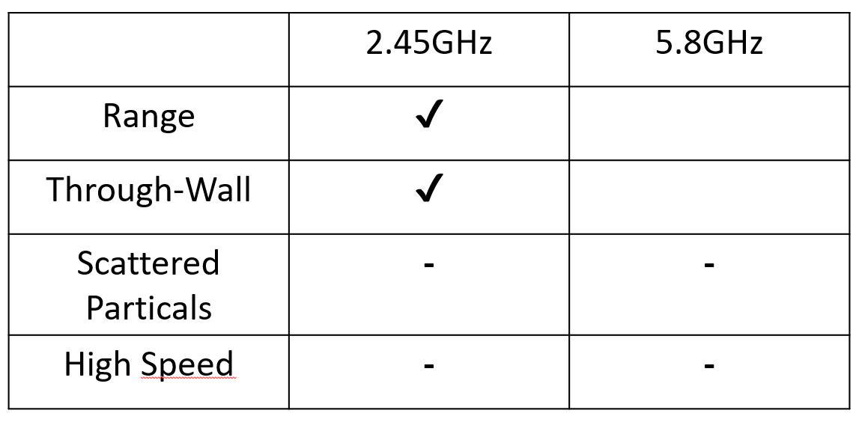
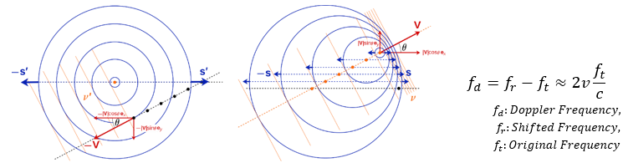

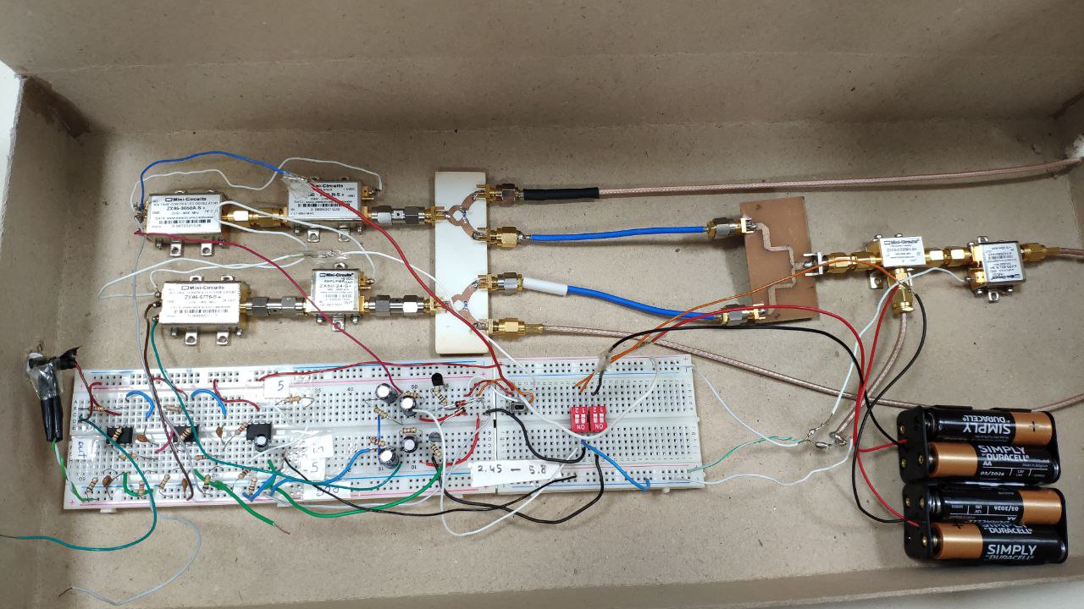
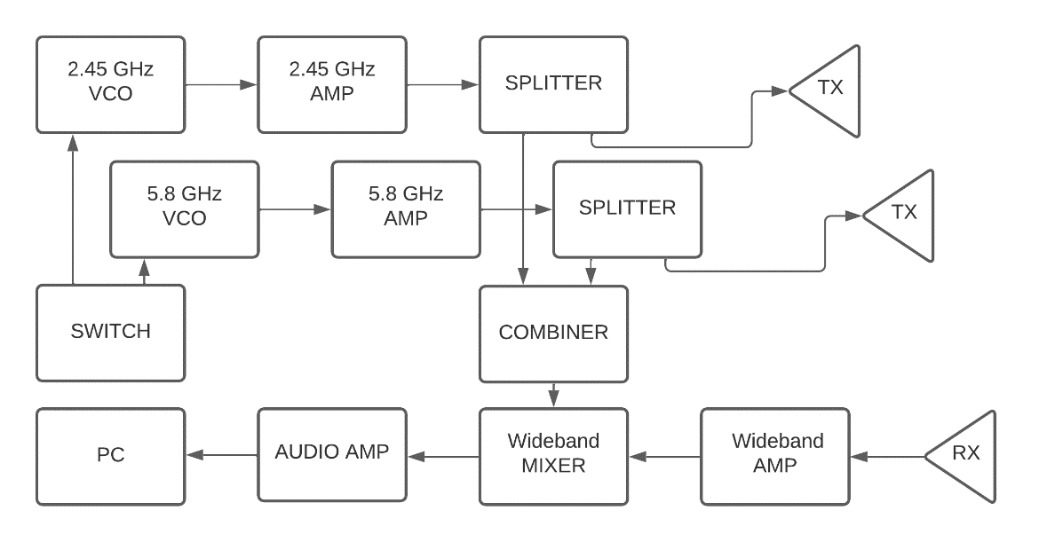
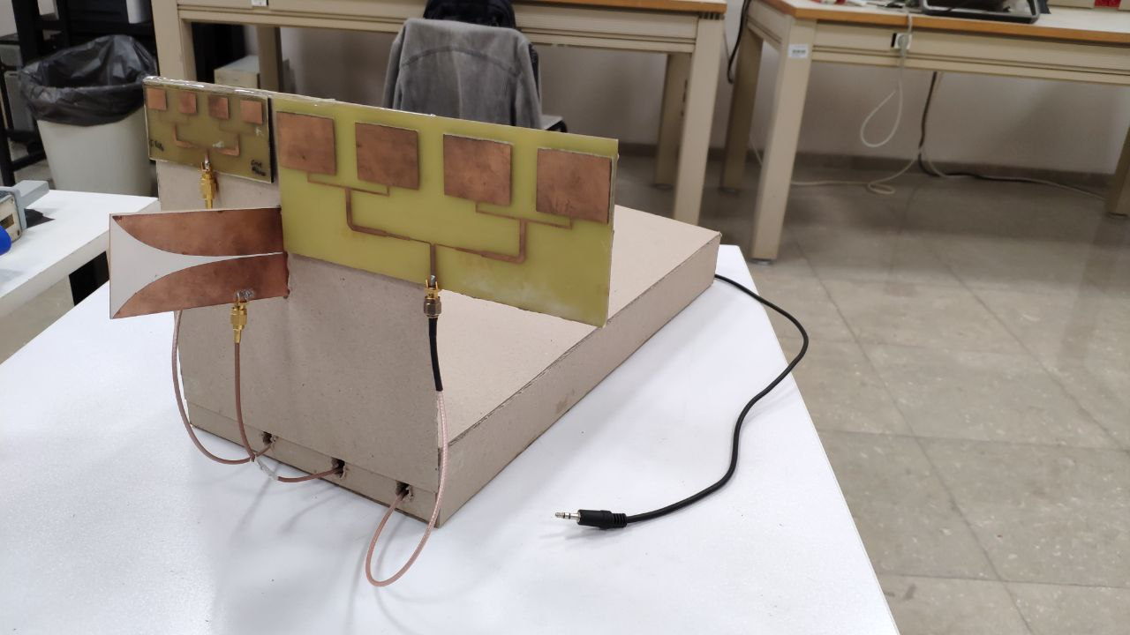
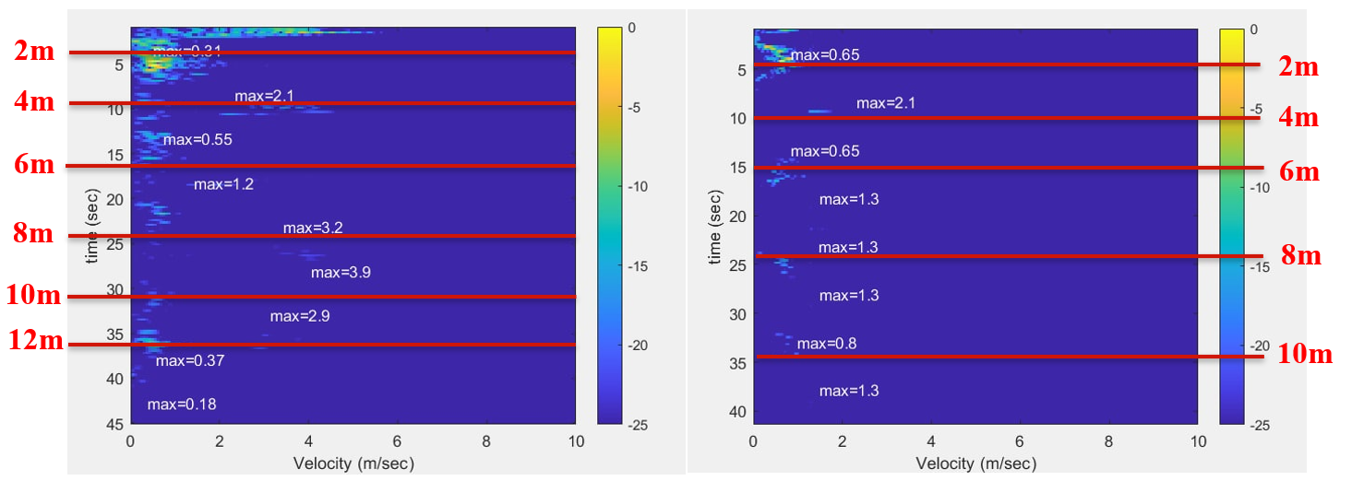
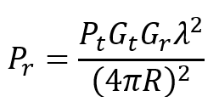
Doppler Radar Measurements
Emre Nedim Hepsağ, Ahmet Yasin Bulut & Fatih Yaman
Izmir Institute of Technology, Izmir, Turkey
Abstract
Measurement of a Doppler Radar
Manufacturing
Wall Test
There are different radar types and techniques with different advantages and disadvantages for different purpose, such as pulse radar and doppler radar. However, among doppler radars, it is not clear that if 5.8GHz is better or 2.45GHz.
Therefore, we tried to figure it out by building a compact, portable combined double radar system to compare them. Instead of using 4 antennas, we designed dual band Vivaldi antenna as common receiver of the system. Also, we designed the system so that we can control the power and radar activation with switches.
By producing our microstrip components with external dry film and UV exposure method, measuring the power output and the gain of the antennas, then doing tests for both frequencies in different conditions, we saw that our practical results are matched with the theoretical calculations.
We concluded that we cannot say that if any of them is better for all situations because according to applications we can prefer one on another.
2.45 GHz Doppler Radar System
Manufacturing Steps
Test Setup with Pendulum
Car Test
5.8GHz
Components we produced
Introduction
Pendulum Test Measurement
2.45GHz
Printed antennas have interesting features for realization. They are easy to manufacture, they have low weight, and they are small. They are durable, compact and also cheap. We can see them in radars, mobile phones, satellites or gps systems.
Microstrip antennas are mostly narrowband which is good for Doppler radars. Moreover, their easy and cheap manufacturing capabilities can help us to produce and test them on the campus.
RADARs are being used as electromagnetic sensors to determine the distance, angle, or velocity of an object. This happens while the transmitter of the radar sensors is sending electromagnetic waves and the receiver is listening to the echo coming from the object.
Doppler is an effect that happens when an object has a velocity related to the wave source, observer. When an object comes towards the observer, the signal reflecting from it is higher than when the object goes backward
Comparison of the Radars
Building 5.8GHz Doppler Radar
Results
5.8 GHz Doppler Radar System
Inside of Final Design
Conclusion
It is clear that with some devices and chemicals, we can produce our board precisely.
Even though power circuits seem relatively simple, in practice, it gets complex and neglected parameters adds up to deflect expected results.
Overall, we can say that 2.45GHz doppler radar performed better for range experiment and through wall experiments which were expected. On the other hand, for scattered particles and high speed high RCS velocity measurements, we cannot say that any of them is better. This is because, at the both situations we were not at the limit of the radars to see the difference.
This system can be improved with more stable power supply and better power amplifiers. It still has some gap to develop for better system.
We think that this system can help others to experiment frequency comparison applications and other doppler radar studies.
To build a microwave system/circuit, there are several components that make us to manipulate the electromagnetic wave. We can give examples of cavities, antennas, waveguides, circulators, filters, and splitters as passive components and amplifiers, mixers, and PLLs as active components.
When signal transmission occurs, some amount of power always returns back to the source which is called return loss. It is one of the most important parameters for initial design, because it represents the ratio of the reflected power to the incident power.
For single port and multiple port devices, to see performance and characteristics, we mostly use the term Scattering Parameters. By looking at the S matrix of a device, we can see if it is lossy or lossless and reciprocal or nonreciprocal as its characteristics.
The directivity shows the radiation direction, mainly on high gain direction. In a doppler radar application like we planned, the antenna must be focused on one direction, and this must be narrow for not radiate to other objects or receive signal from side directions.
From the Friss’s transmission formula we can denote the gain and the distance relation.
Designing a Portable System
Combined Radar System
Completed Case
Radar Range Test
Reference
[1] A. Pandey, Practical Microstrip and printed antenna design. London, Boston: Artech House, 2019
[2] D. M. Pozar and D. H. Schaubert, “basic microstrip antenna elements and feeding techniques,” in Microstrip antennas: The analysis and design of microstrip antennas and arrays, New York: Institute of Electrical and Electronics Engineers, 1995, pp. 60–90.
[3] C. A. Balanis, Antenna theory: Analysis and design. Hoboken: John Wiley, 2016.
[4] H. T. Friis, “A note on a simple transmission formula,” Proceedings of the IRE, vol. 34, no. 5, pp. 254–256, 1946.

